Slide 1
Deep Learning Hands-On

Slide 2
BREAK

Slide 3
Deep Learning in One Slide
Exciting Progress:
Face recognition
Image classification
Speech recognition
Text-to-speech generation
Handwriting transcription
Machine Translation
Medical diagnosis
Autonomous driving
Game playing with deep RL
What is it:
Extract useful pattern from data
How:
Neural Networks + optimization
Tools:
Python + Tensorflow & Others
Hard Part:
Good Questions + Good Data

Slide 4
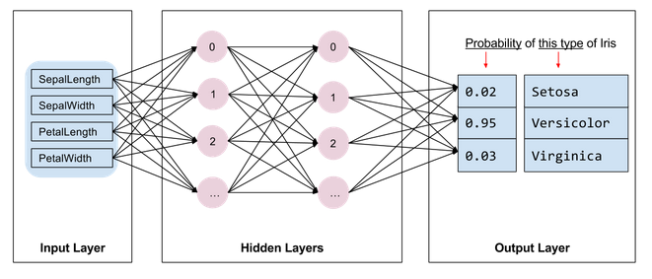

Slide 5

Tensorflow in One Slide
What is it: Deep Learning Library
Open Source, Python, Google
Community:
117,000+ GitHub stars
Tensorflow.org: Blogs, Documentation, Youtube talks
Ecosystem:
Keras: high-level API
Tensorflow.js: in the browser
Tensorflow Lite: on the phone
Colaboratory: in the cloud
TPU: optimized hardware
Tensorboard: visualization
Tensorflow Hub: graph models
Extras:
Tensorflow Serving
Tensorflow Extended
Tensorflow Probability

Slide 6
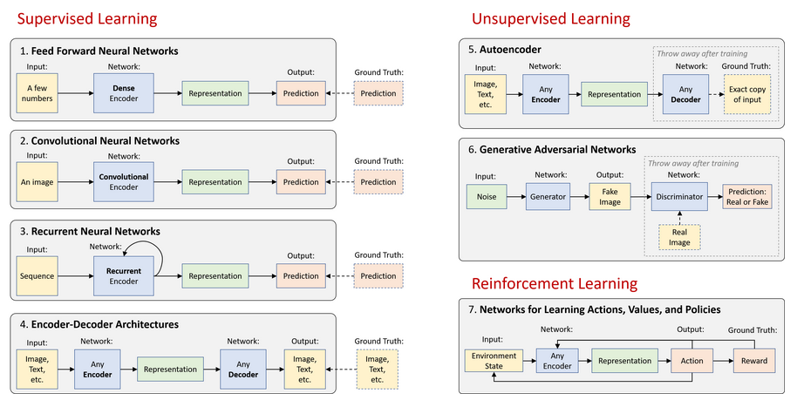

Slide 7
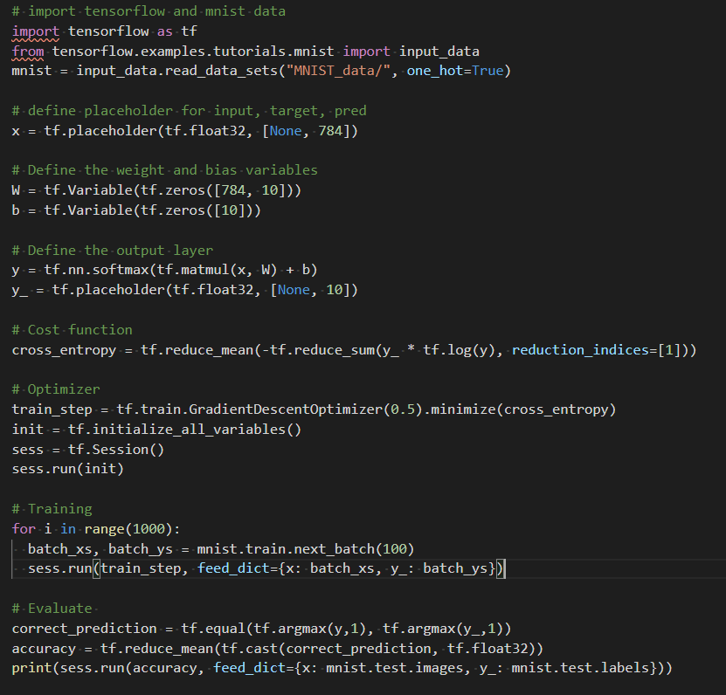
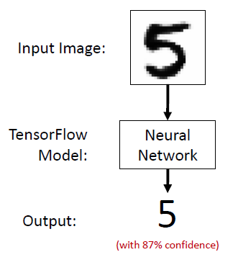
First Steps: Small Example

Slide 8
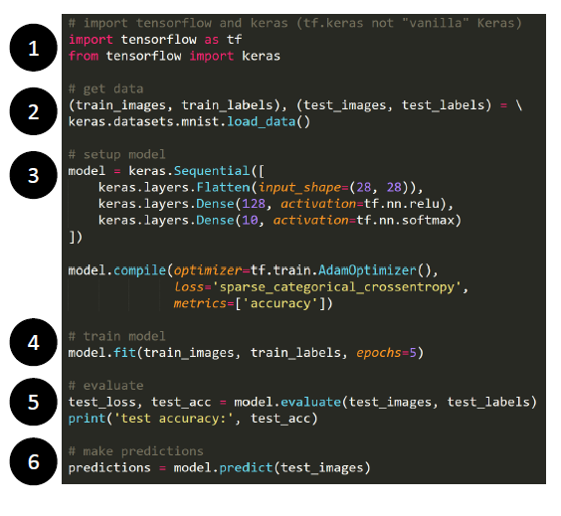
First Steps: Small Example

Slide 9
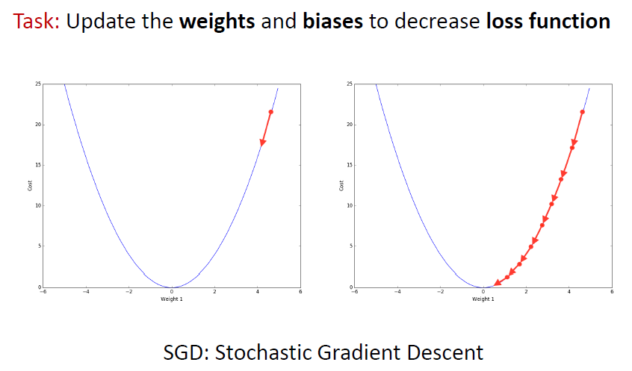
Learning is an Optimization Problem

Slide 10
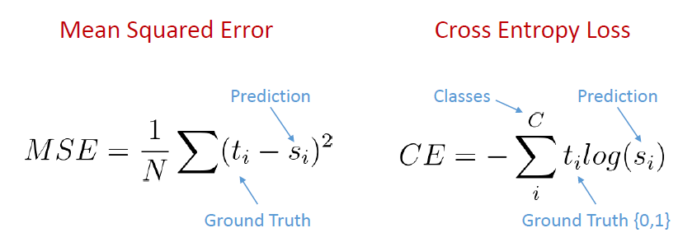
Loss Functions
Quantifies gap between prediction and ground truth
Regression
Classification

Slide 11
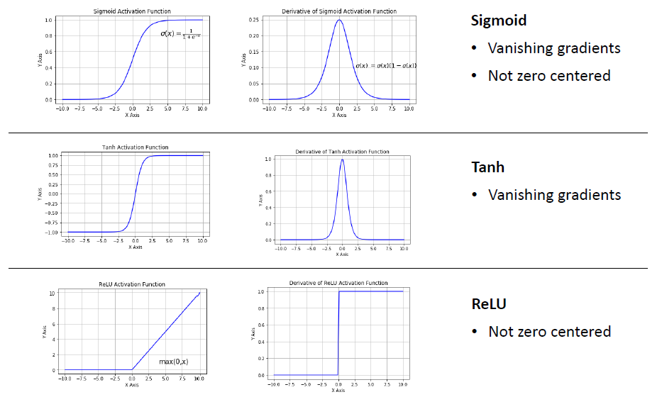
Activation Functions

Slide 12
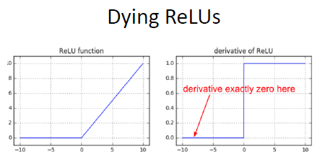
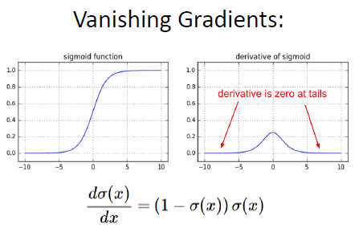
Common obstacles in DL
Poorly initialized, a neuron might never “fire” for the entire dataset
Large parts of a network could be dead ReLUs!
Backpropagation:
Partial derivatives are small then the learning is slow

Slide 13
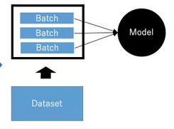
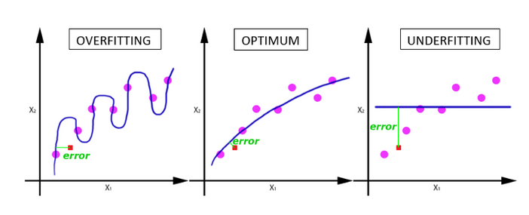
Overfitting and Regularization
Network should be able to generalize to data it hasn’t seen
Big problem for small dataset
Mini-Batch Size:
Large dataset cannot pass entire to the network, we should divide into a certain number of batches
Larger batch size = more speed
Smaller batch size = better generalization

Slide 14
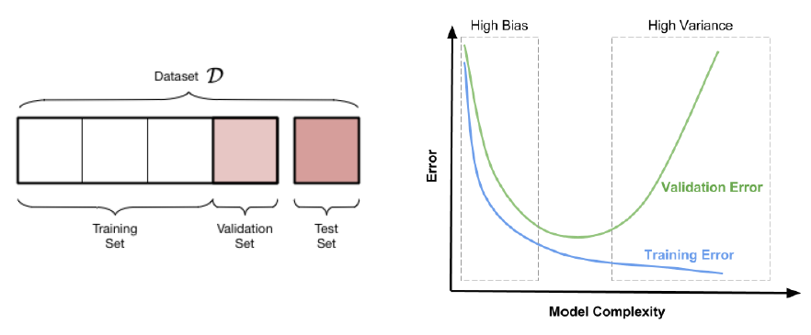
Regularization: Early Stopping
Create a validation set (assume to be a representation of the testing set)
Early stopping: Stop an save the last checkpoint when performance on
validation set decreases

Slide 15
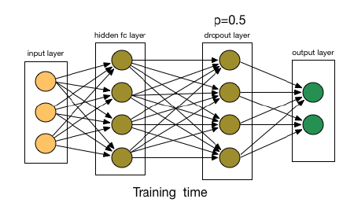
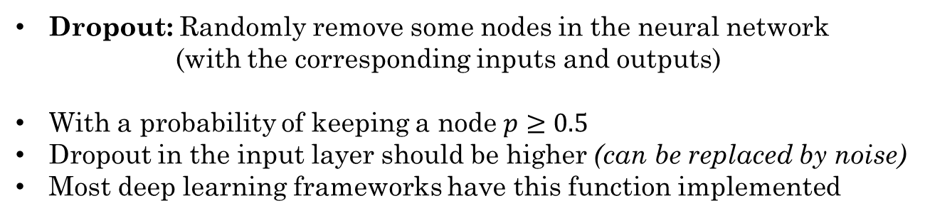
Regularization: Dropout
Dropout: Randomly remove some nodes in the neural network
(with the corresponding inputs and outputs)
With a probability of keeping a node $p≥0.5$
Dropout in the input layer should be higher (can be replaced by noise)
Most deep learning frameworks have this function implemented

Slide 16
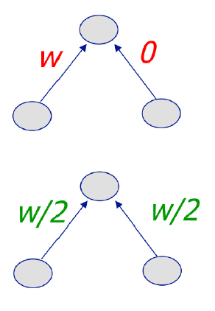
Regularization: Weight Penalty
L2 Penalty
Keeps weight small unless error derivative is very large
Prevent from fitting sampling error
Output changes slower as the input changes
Balance similar inputs instead of weight all on one
L1 Penalty
Allow for few weights to remain large
Penalize absolute weights

Slide 17
Regularization: Normalization
Input Normalization
Manage the input scale
Whitening
Scale according to the mean and std.
Batch Normalization
Normalize hidden layer inputs
Use mini-batch mean and variance
Reduce the impact of earlier layers to more deep layers
Batch Renormalization
Fixes difference b/w training and inference by keeping a moving average asymptotically approaching a global normalization

Slide 18
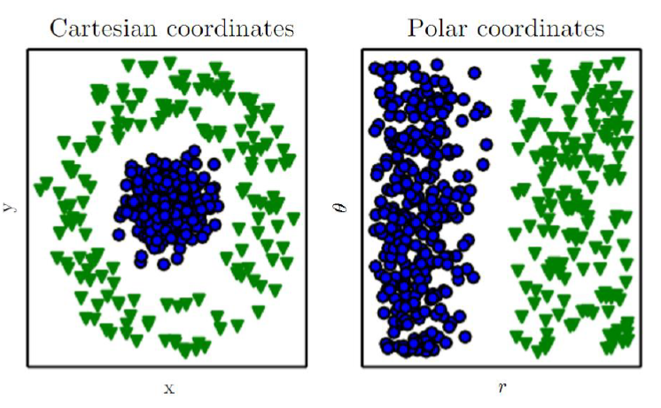
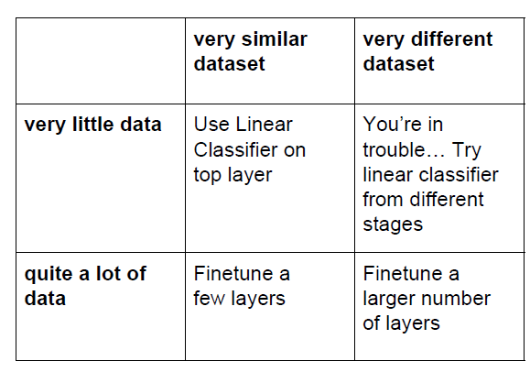
Representation and Data Dimension

Slide 19
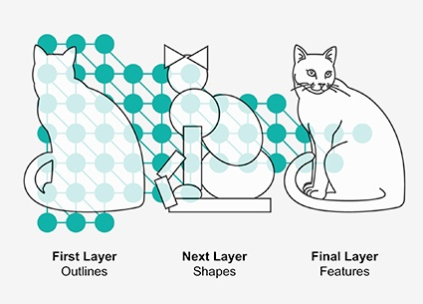
Convolutional Neural Networks

Slide 20
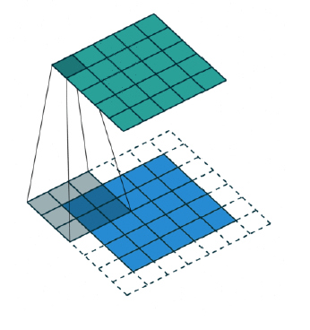
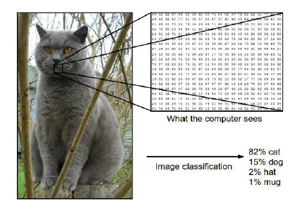
Convolution Networks
Filter that take
Advantage of
Spatial invariance

Slide 21
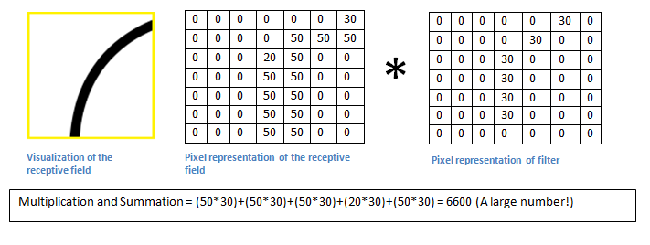
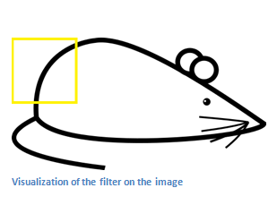

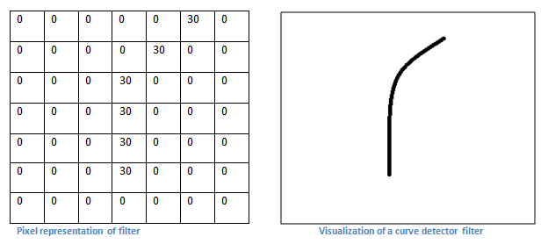
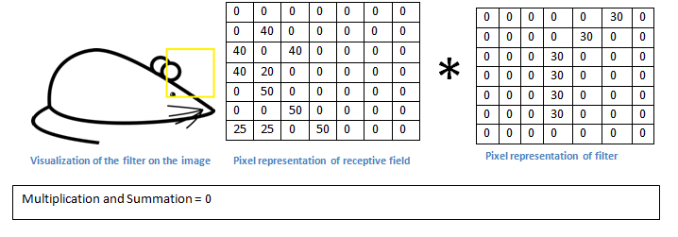
Convolution Networks
Input Data
Convolution filter

Slide 22
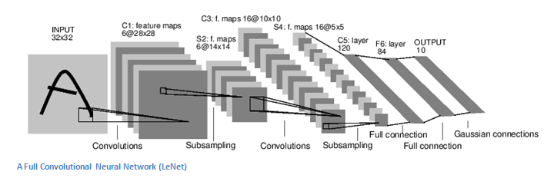
Convolution Networks

Slide 23
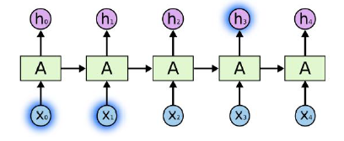
Recurrent Neural Networks

Slide 24
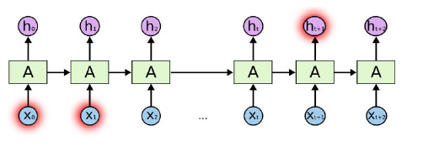
Recurrent Neural Networks
(Long-Term Dependency)
Short-Tem dependence
Bob is eating an apple.
Long-Term dependence
Bob likes apples. He is hungry and decided to have a snack. So now he is eating an apple.
In theory, vanilla RNN can handle arbitrarily long-term dependence
(In practice, it’s difficult)

Slide 25
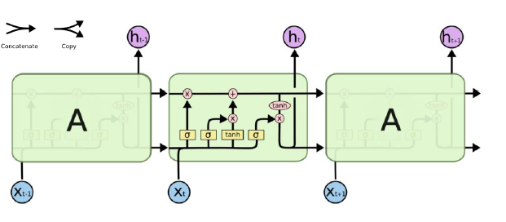
Long Short-Term Memory (LSTM)
Pipeline for storing a previous state and process new incoming data:
Decide what to forget
Decide what to remember
Decide what to output

Slide 26
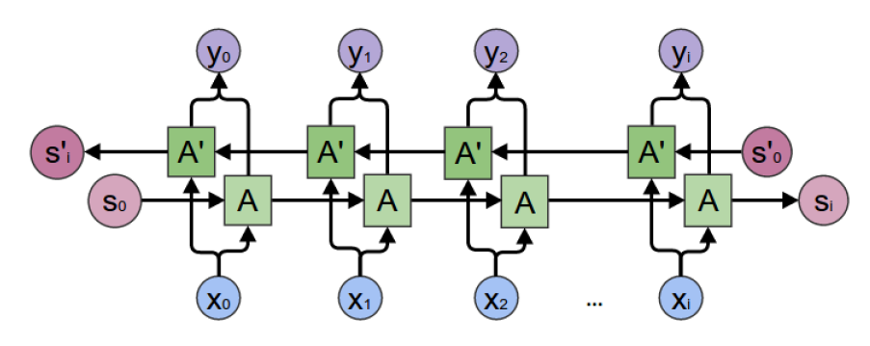
Bidirectional RNN
Learn a representation after watching a sequence from both:
Previous time steps and future time steps

Slide 27
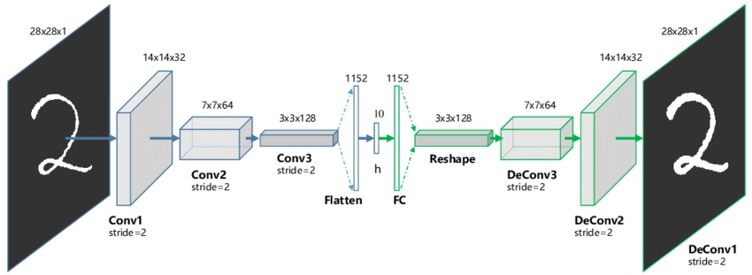
Autoencoder Neural Networks

Slide 28
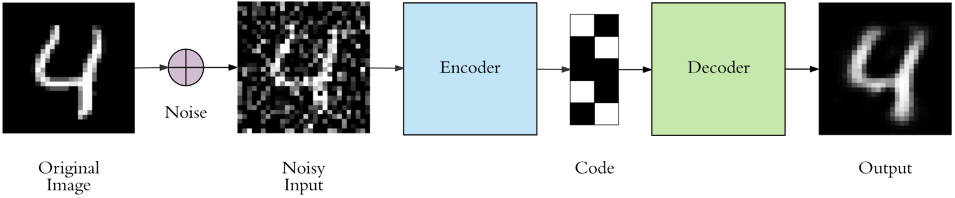
Autoencoder Networks

Slide 29
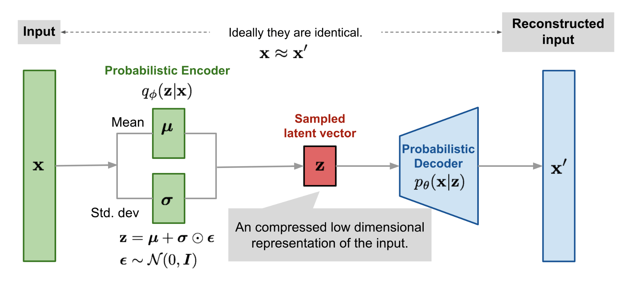
Variational Autoencoder

Slide 30
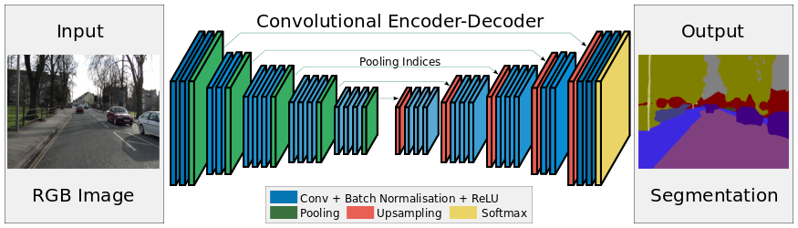
U-Net Autoencoder

Slide 31
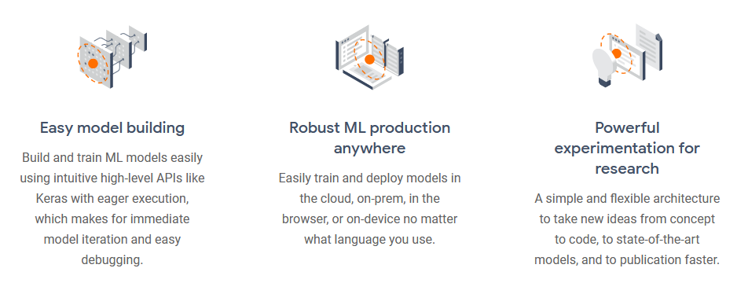
Recent Works for Time Series* *available code

Slide 32
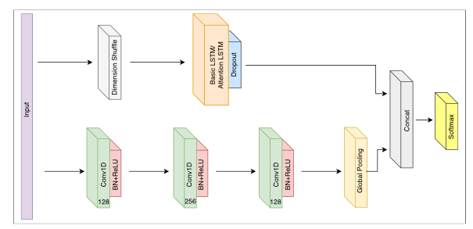
LSTM Fully Convolutional Networks for Time Series Classification
https://ieeexplore.ieee.org/stamp/stamp.jsp?tp=&arnumber=8141873
https://github.com/titu1994/LSTM-FCN

Slide 33
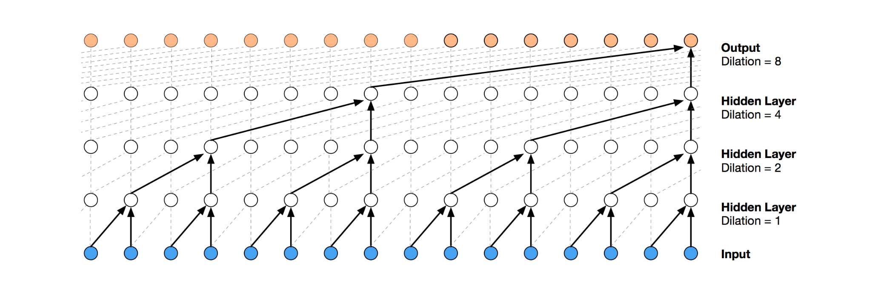
An Empirical Evaluation of Generic Convolutional and Recurrent Networks for Sequence Modeling
https://arxiv.org/pdf/1803.01271v2.pdf
https://github.com/philipperemy/keras-tcn

Slide 34
Thanks
Contact:
patoalejor@gmail.com

